Slide 1

SMART PLUG
EDUCATIONAL DIY KIT

Slide 2
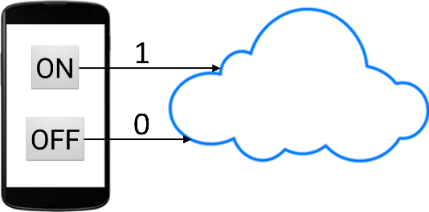
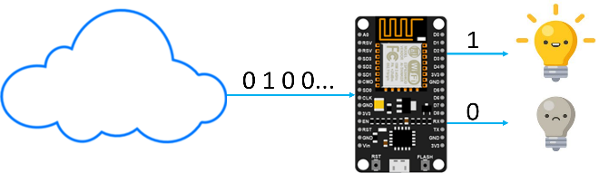
About the Kit
DIY Home Automation Kit
Key Features:
Remotely control any appliance using an app
No batteries required
How does the system work?
When the user presses a button on the app, data is sent by the app and is stored on the cloud. Value 1 is sent if ON button is pressed and value 0 is sent if OFF button is pressed.
NodeMCU on the kit constantly reads data from the cloud. If it reads value 1 from the cloud, it switches ON the relay which turns the appliance ON. If the NodeMCU reads value 0 from the cloud, it switches OFF the relay which turns OFF the appliance.

Slide 3
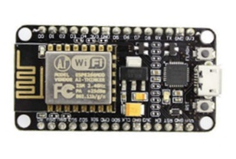
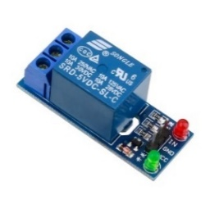
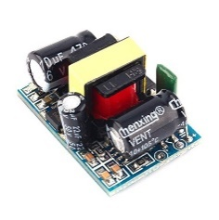
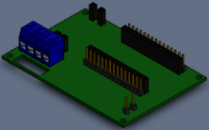
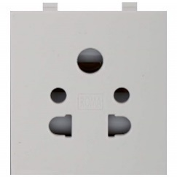
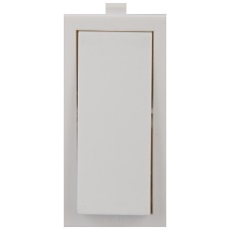
LIST OF COMPONENTS
COMPANY PORTFOLIO
NodeMCU x1
Single Channel Relay Module x1
AC to DC 5v Converter x1
PCB x1
Socket x1
Switch x1
Plug x1
USB Cable x1
Left Side Plate x1
Right Side Plate x1
Back Plate x1
Front Plate x1
Top Plate x1
Bottom Plate x1
Partition x1
Nuts and Bolts x80
Jumper Wires
Wires

Slide 4
DEFINITION OF COMPONENTS
COMPANY PORTFOLIO
RELAY
A relay is an electromagnetic switch operated by a relatively small electric current that can turn on or off a much larger electric current.
NODEMCU
NodeMCU is an open source IoT platform. It includes firmware which runs on the ESP8266 Wi-Fi SoC from Espressif Systems, and hardware which is based on the ESP-12 module.
ESP8266
The ESP8266 is a low-cost Wi-Fi microchip with full TCP/IP stack and microcontroller capability produced by manufacturer Espressif Systems in Shanghai, China.
THINGSPEAK
ThingSpeak is an open-source Internet of Things (IoT) application and API to store and retrieve data from things using the HTTP protocol over the Internet or via a Local Area Network.

Slide 5
DATA FLOW DIAGRAM
COMPANY PORTFOLIO
APP
APP
THINGS SPEAK
THINGSPEAK
NODEMCU
NODEMCU
RELAY
RELAY
SWITCH
SWITCH

Slide 6

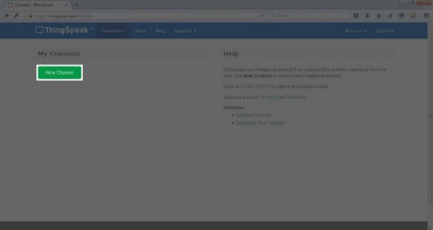
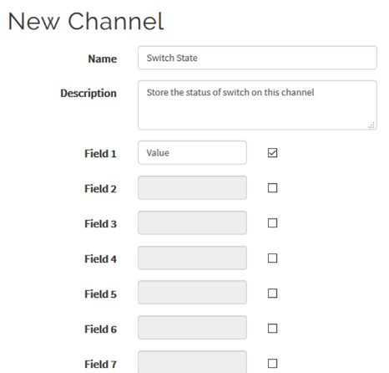
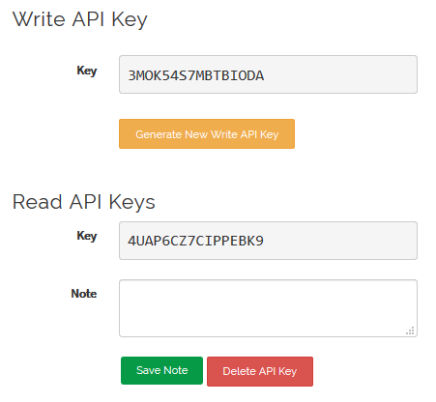
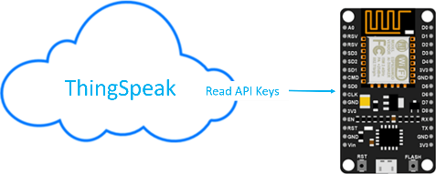
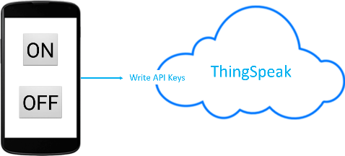
STEP 1 >> LOG IN THINGSPEAK
1. THINGSPEAK SET UP
COMPANY PORTFOLIO
CREATE AN ACCOUNT
https://www.thingSpeak.com/
STEP 2 >> CREATE A NEW CHANNEL
TO STORE AND RETRIEVE DATA
Save the channel after filling in the details.
(Name, Channel 1)
STEP 3 >> ACCESS API KEYS
API WRITE KEY ALLOWS DATA TO BE WRITTEN
API READ KEY ALLOWS DATA TO BE READ

Slide 7
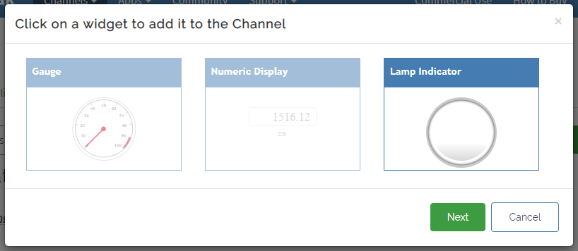
THINGSPEAK SET UP
COMPANY PORTFOLIO
STEP 4 >> ADDING WIDGET
Go to your thingspeak channel >> Private View >> Add widgets >> Select lamp Indicator >> Enter the name of lamp indicator >> Select the lamp colour to yellow

Slide 8
2. APP CREATION
COMPANY PORTFOLIO
STEP 1 : APP CREATION
www.ai2.appinventor.mit.edu
Click create app
STEP 2 : NEW PROJECT
Name the project
“Smart Plug ”
STEP 3 : FRONT END
Drag Button
Rename to ON / OFF
STEP 4 : ADD WEB CONNECTIVITY
Add when Button1. Click Do …
Http “API Key “
STEP 5 : INSTALL APP
App is ready to install
STEP 6 : APP TESTING
Glowing of lamp indicator shows app is working perfectly.

Slide 9


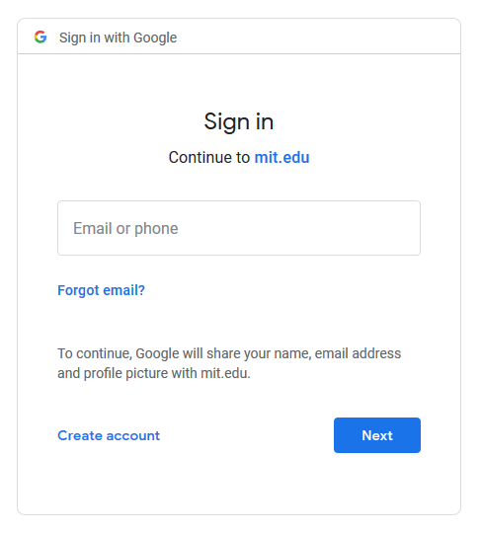
APP CREATION
COMPANY PORTFOLIO
STEP 1 : App creation
Step 1.1: Go to ai2.appinventor.mit.edu
And click “Create Apps”
Step 1.2 : A google sign will be required to create an app.
Use your GMAIL ID or create a new one.

Slide 10
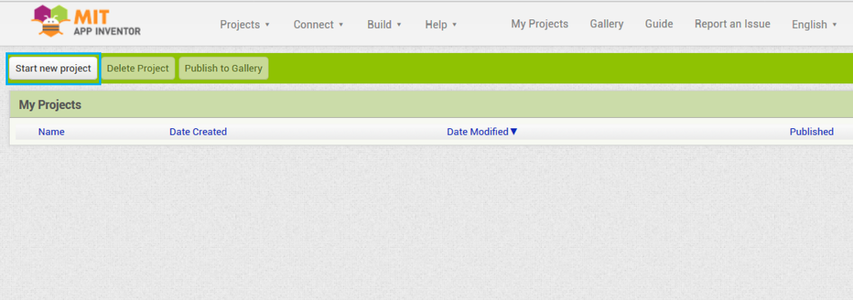
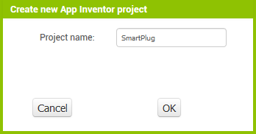
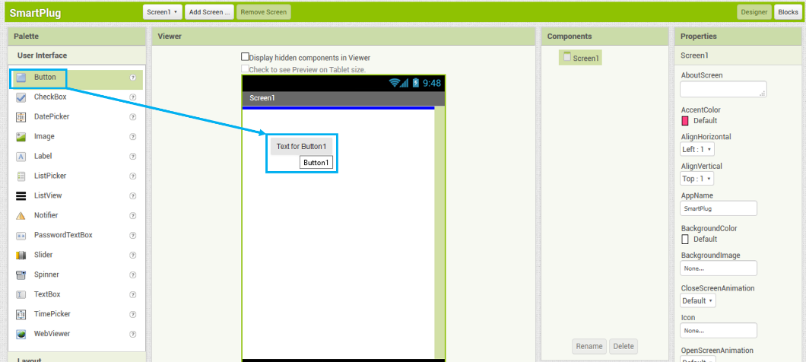
APP CREATION
COMPANY PORTFOLIO
STEP 2 : New Project
Step 2.1: Click on the “Create Project” button.
Step 2.2: Name your project “ Smart Plug”
STEP 3 : Front End Design
Step 3.1: Drag a button

Slide 11
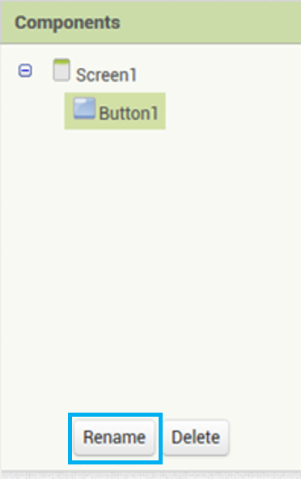
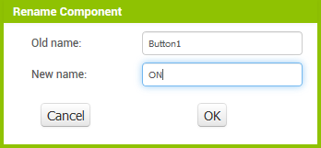
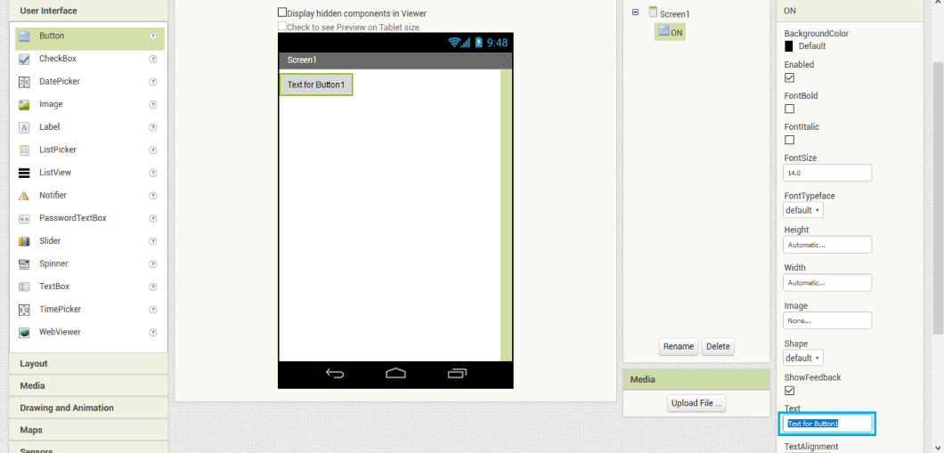
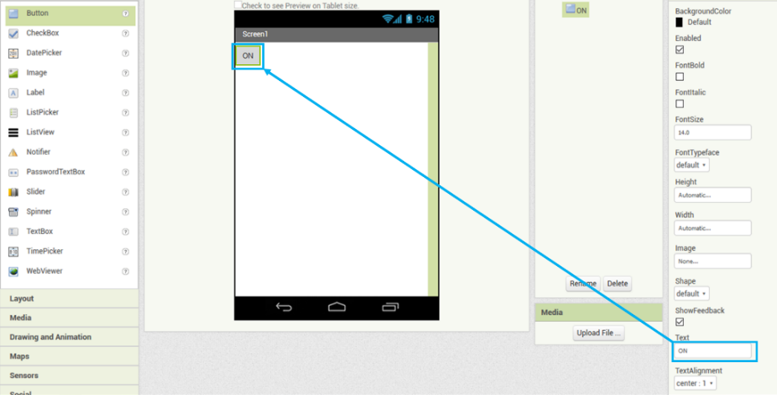
APP CREATION
COMPANY PORTFOLIO
Step 3.2 : Rename it to “ON”. This will change its name on the backend side of the app
Step 3.3 : Rename the name on Frontend side too.
Step 3.4 : Similarly, add another button and change its name to “OFF” on both backend and frontend side

Slide 12
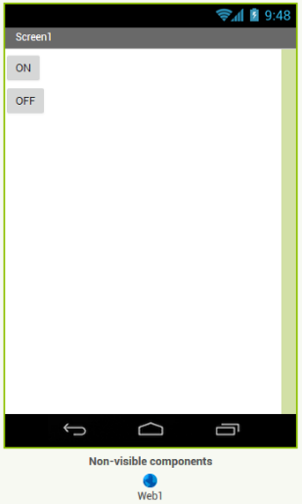
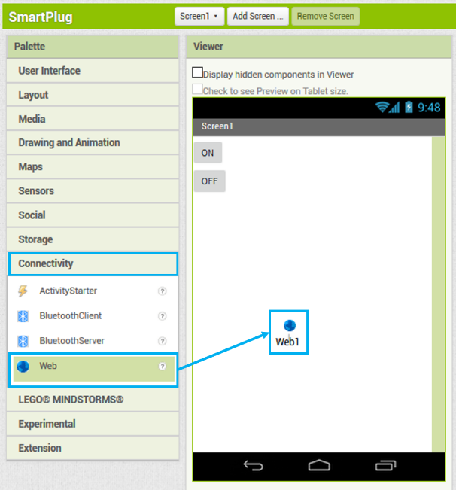
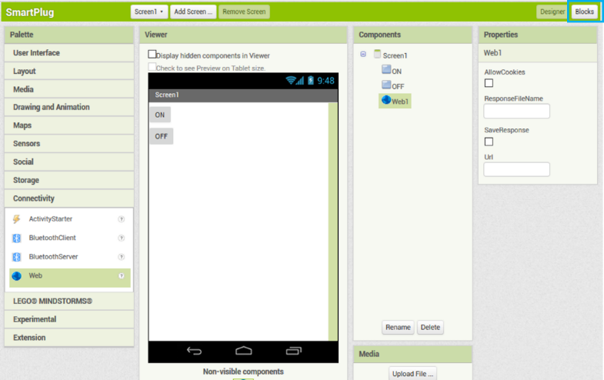
APP CREATION
COMPANY PORTFOLIO
Step 3.5 : Add web component to the screen from the “Connectivity” Palette
Step 4 : WEB CONNECTIVITY
Step 4.1: Drag the web component from the “Connectivity” Palette

Slide 13
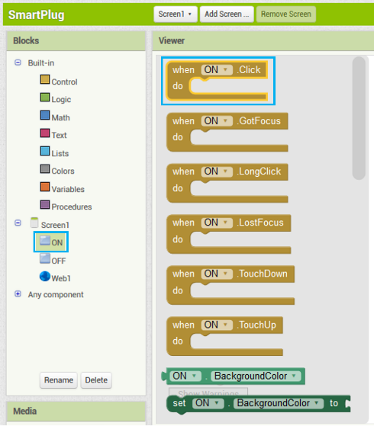
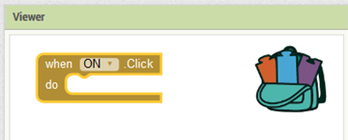
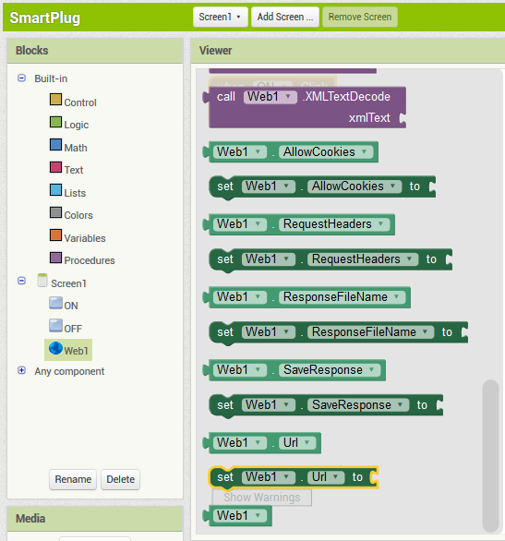
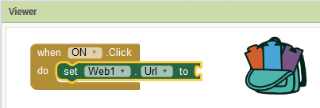
APP CREATION
COMPANY PORTFOLIO
Step 4.2 : From the “ON” button drawer, select “when Button1.Click do” block and drag it in the workspace.
Step 4.3 : Add a “set Web1.Url” block and connect it to the “when Button1.Click do” block

Slide 14
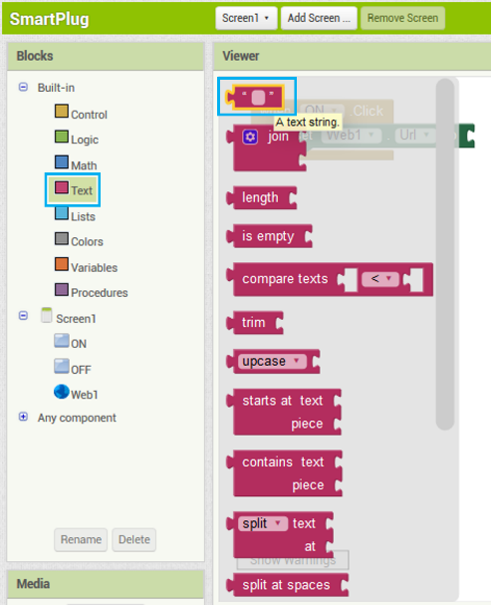
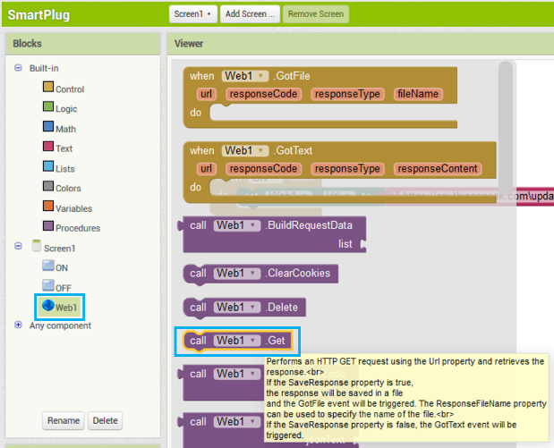
APP CREATION
COMPANY PORTFOLIO
Step 4.4: Add a “text string” block and connect it to “set Web1.Url” block
Step 4.5: In the text block, write the following:
https://api.thingspeak.com/update?api_key=3MOK54S7MBTBIODA&field1=1
In place of the word “3MOK54S7MBTBIODA”, write the WRITE API KEY of your own ThingSpeak channel.
Step 4.6: Add a “call.Web1.get” block to send the http request.

Slide 15
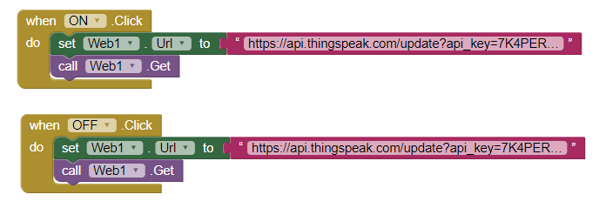
APP CREATION
COMPANY PORTFOLIO
Step 4.7: This means that every time you click the “ON” button, the web URL will be set to https://api.thingspeak.com\update?api_key=3MOK54S7MBTBIODA &field1=1 and a value of 1 will be sent to the ThingSpeak channel at field1.
Do the same for OFF button. However, a value of 0 will be sent to ThingSpeak instead of 1. The web URL will thus be:
https://api.thingspeak.com\update?api_key=3MOK54S7MBTBIODA&field1=0
In place of “3MOK54S7MBTBIODA”, write the WRITE API KEY of your own ThingSpeak channel.
Step 5: Install the app Step 5.1: After completing all the step, click on the “App( provide QR code .apk)”. Now scan the QR code from your smartphone, it will download the apk to your phone’s local storage. Now install it, and now your app is ready to control your home appliances

Slide 16
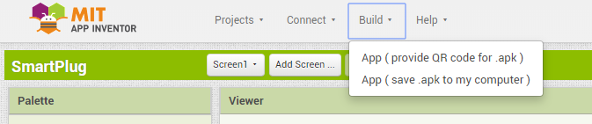
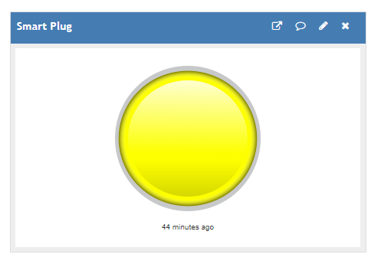
APP CREATION
COMPANY PORTFOLIO
Step 6: APP TESTING
If the lamp indicator glows on pressing the ON button and turn off when pressing the OFF button then app is working perfectly.

Slide 17
3. CODE DESIGN – Node MCU
COMPANY PORTFOLIO
STEP 1 : SET UP TUNIOT
http://easycoding.tn/TUNIOT/demos/code/
STEP 2 : WIFI CONNECTIVITY
Enter Wi-Fi Name and Password
STEP 3 : CONNECT TO CLOUD
Procure data from Thing Speak
STEP 4 : CONDITIONAL PROGRAM
Complete Logical Programming
STEP 5 : COPY TO ARDUINO IDE
Copy code to Arduino IDE
STEP 6 : CONNECT TO NODE MCU DEV KIT
Add ESP to Arduino IDE
Select Com Port
STEP 7 : ADDING THINGSPEAK LIBRARY
Adding thingspeak library to Arduino IDE
STEP 8 : UPLOAD CODE
Upload code to Node MCU

Slide 18
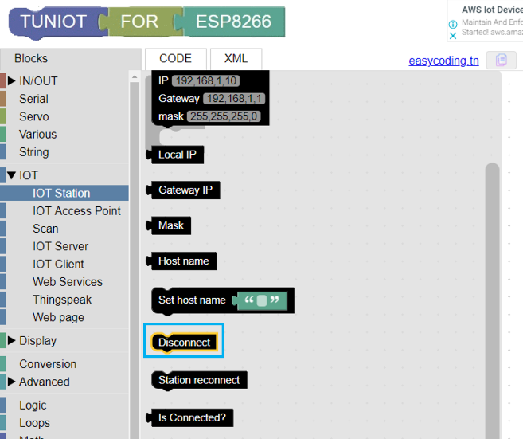
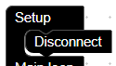
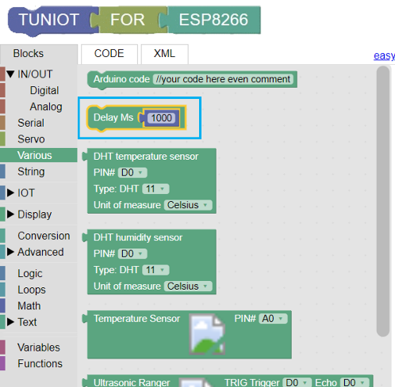
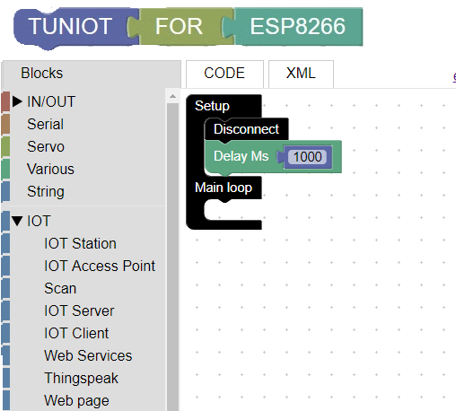
CODE DESIGN – Node MCU
http://easycoding.tn/TUNIOT/demos/code/
TUNIOT
TUNIOT is a code generator for the ESP8266\ESP32 boards. You don't need any coding skills to program it and make your IoT project.
First we’ll work on the setup block as it’ll run only once and initialize the NodeMCU
STEP 1 : SET UP TUNIOT
Step 1.1: First place the “Disconnect” block in the setup block.
Step 1.2: Give one second delay using the “Delay” block

Slide 19
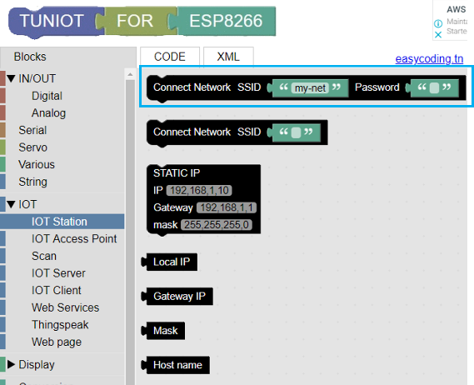
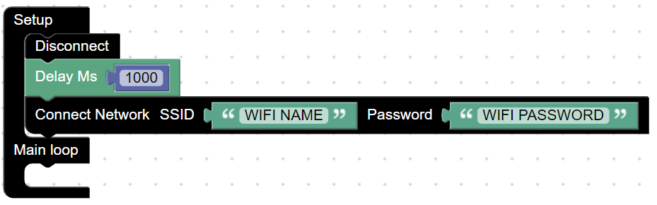
CODE DESIGN – Node MCU
COMPANY PORTFOLIO
STEP 2 : WIFI CONNECTIVITY
Step 2.1: “Connect Network” block tell the NodeMCU to connect to the Wi-Fi whose details are being entered in the SSID and Password field.
In the block my net enter the network name and similarly add the password of your network.

Slide 20
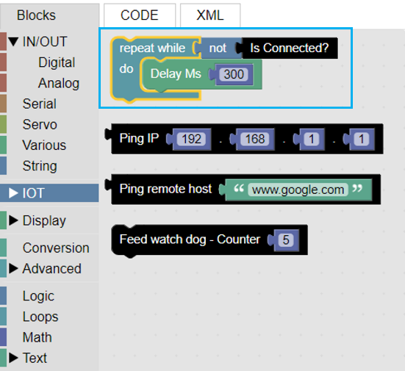
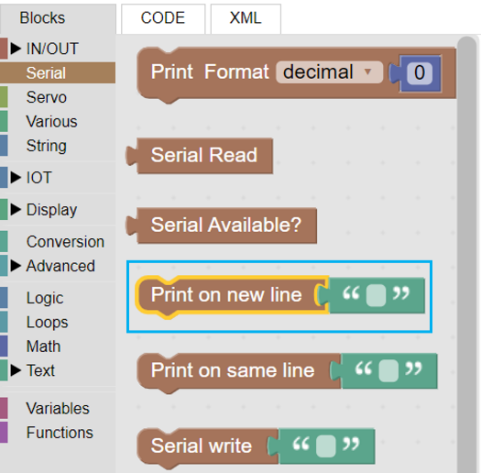
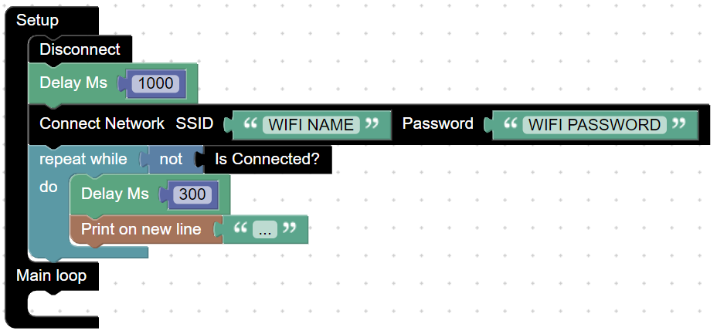
CODE DESIGN – Node MCU
COMPANY PORTFOLIO
Step 2.2: Now a “repeat while” block is used to wait till the Wi-Fi is connected. And for our reference a dot (.) is being printed every 300ms

Slide 21
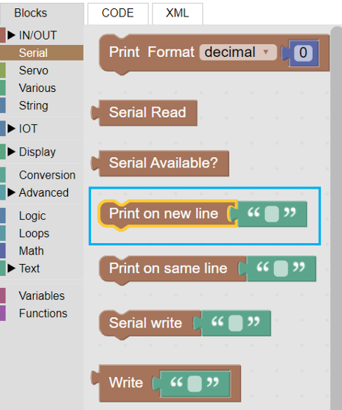
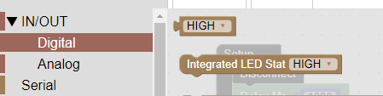
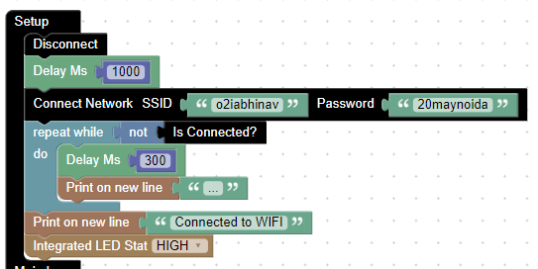
CODE DESIGN – Node MCU
COMPANY PORTFOLIO
Step 2.3: The loop will be exit as soon as the Wi-Fi is connected and a text will be printed to let us know the same using the “Print on new line” block

Slide 22
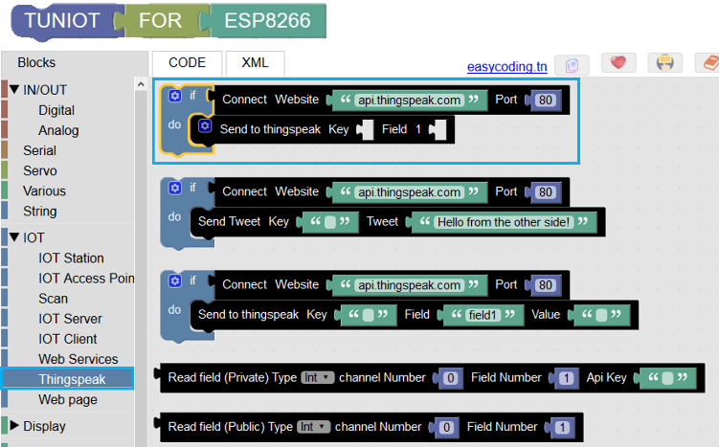
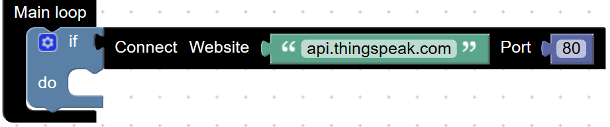
CODE DESIGN – Node MCU
COMPANY PORTFOLIO
STEP 3 : CONNECT TO CLOUD
Step 3: Use the “Connect Network” block to connect to the ThingSpeak website and procure data

Slide 23
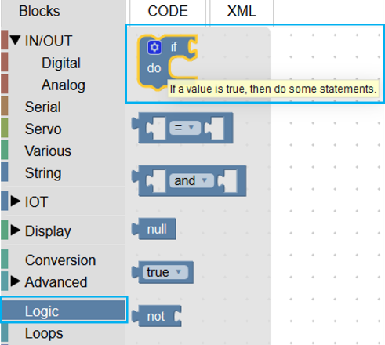
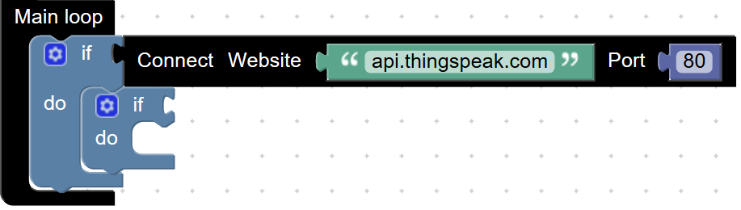


CODE DESIGN – Node MCU
COMPANY PORTFOLIO
STEP 4 : CONDITIONAL PROGRAM
Step 4.1: Use the “if-do” block to make some conditional logic programming. This will be used to check the value of the ThingSpeak channel and power ON/OFF the relay module accordingly.

Slide 24




CODE DESIGN – Node MCU
COMPANY PORTFOLIO
Step 4.2: Enter the ThingSpeak details like “Read API key” and channel ID in the “Read field” block.

Slide 25



CODE DESIGN – Node MCU
COMPANY PORTFOLIO
Step 4.3: Use “DigitalWrite” block to control the relay (i.e. HIGH/LOW). Here “D1” means the pin no “D1” on the NodeMCU

Slide 26




CODE DESIGN – Node MCU
COMPANY PORTFOLIO
STEP 5 : COPY TO ARDUINO IDE
Step 5.1 : Copy the code from TUNIOT by clicking on the copy button.

Slide 27

CODE DESIGN – Node MCU
COMPANY PORTFOLIO
Download link of Arduino IDE
https://www.arduino.cc/en/Main/Donate
Step 5.2 : Paste the copied code in the Arduino IDE
SERIAL MONITOR
The Arduino IDE has a feature that can be a great help in debugging sketches or controlling Arduino from your computer's keyboard. The Serial Monitor is a separate pop-up window that acts as a separate terminal that communicates by receiving and sending Serial Data.

Slide 28
CODE DESIGN – Node MCU
COMPANY PORTFOLIO
#include <ESP8266WiFi.h>
#include <ThingSpeak.h>
WiFiClient client;
void setup()
{
Serial.begin(9600);
ThingSpeak.begin(client);
pinMode(16, OUTPUT);
WiFi.disconnect();
delay(1000);
WiFi.begin("WIFI NAME", "WIFI PASSWORD");
while ((!(WiFi.status() == WL_CONNECTED)))
{
delay(300);
Serial.println("...");
}
Serial.println("Connected to Wifi");
}
void loop()
{
if (client.connect("api.thingspeak.com", 80)) {
if ((ThingSpeak.readIntField(12345, 1, "API KEY")) == 1)
{
digitalWrite(16, LOW);
} else if ((ThingSpeak.readIntField(12345, 1, "API KEY")) == 0)
{
digitalWrite(16, HIGH);
}
}
}

Slide 29


CODE DESIGN – Node MCU
COMPANY PORTFOLIO
STEP 6 : CONNECT TO NODE MCU DEV KIT
Step 6.1: Add ESP8266 board in the Arduino IDE, as Arduino doesn’t have it by default.
Go to File >> Preferences >> Settings
In the “Additional Board Manager URLs” field add
http://arduino.esp8266.com/stable/package_esp8266com_index.json
Step 6.2: Now go to Tools >> Boards >> Board Manager and install the ESP8266 board.

Slide 30

CODE DESIGN – Node MCU COMPANY PORTFOLIO STEP 7 : INCLUDING THE THINGSPEAK LIBRARY Add the thingspeak library in Arduino IDE. Go to sketch >> Include Library >> Manage Library >> Search for thingspeak >> Install the library

Slide 31




CODE DESIGN – Node MCU
COMPANY PORTFOLIO
Step 8: Upload the code to the NodeMCU board
Make sure you’ve selected the Board as “Node MCU 1.0” and COM Port

Slide 32
4. ASSEMBLY
COMPANY PORTFOLIO
STEP 1 : MOUNT PCB
Fix on base plate
Make connections
STEP 2 : ASSEMBLE
Fix Base First
Assemble
STEP 3 : PLUG CONNECTIONS
Assemble Plug
Switches
STEP 4 : RELAY CONNECTIONS
Complete Relay Connections
STEP 5 : POWER UP
Test

Slide 33


ASSEMBLY
COMPANY PORTFOLIO
STEP 1 : MOUNT PCB
Step 1.1: Fix PCB on base plate
Step 1.2: Make connections
Make the connections as shown in the circuit diagram

Slide 34




ASSEMBLY
COMPANY PORTFOLIO
STEP 2 : ASSEMBLY
Step 2.1: Place all the panels in its place.

Slide 35



ASSEMBLY
COMPANY PORTFOLIO
Step 2.2: Final output should be same as it is shown in the figure
Step 3: Plug Connections: Step 3.1: Connect the red and black wires from the plug to the screw terminals marked Live and Neutral.
Step 3.2: Switch Connections
Connect one end of the Switch to the screw terminal marked “Live”.
Connect the other end of the screw terminal to the end of the socket marked “L”.

Slide 36


ASSEMBLY
COMPANY PORTFOLIO
Step 4: Relay Connections Step 4.1: Output Side
Connect “NO” terminal of the Relay to the screw terminal marked “Neutral”.
Connect “COM” terminal of the Relay to the end of the socket marked “N”.
Step 4.2: Control Side
Connect the “Vcc” pin of Relay to the pin adjacent to it marked “Vcc”.
Connect pin “D1” of NodeMCU to the Relay module pin marked “IN”.

Slide 37
5. TESTING
COMPANY PORTFOLIO
STEP 5 : Testing
GLOWING OF RELAY LED
When the Relay is connected to the wifi then the LED glows.
If Thingspeak is showing ON then our Electrical Appliance must be ON and if ThingSpeak is showing Off then our Appliance must be Off.
FINAL TESTING THROUGH APP
Relay is functional and making and breaking the circuit by the Smart Plug App.

Slide 38

TESTING
COMPANY PORTFOLIO
Glowing Of Relay LED
After all the connections of the relay with the NODE MCU the RED LED of the relay must be on .

